Slide 1
301 Oct 3, Class 8
APA format writing
  Scientific communication

Slide 2
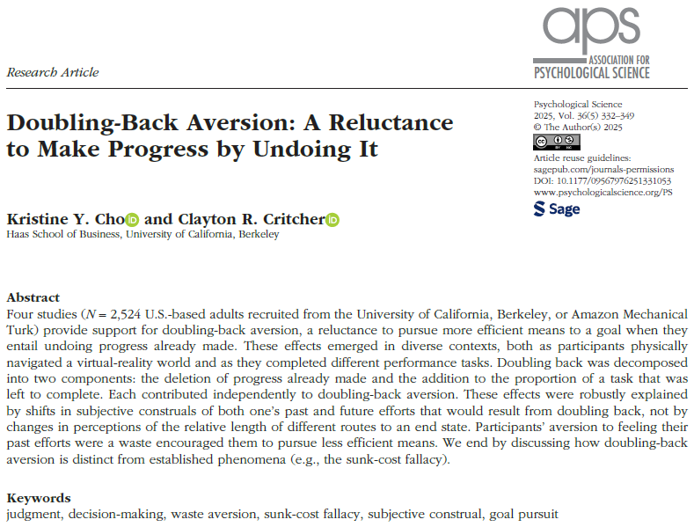

Slide 3
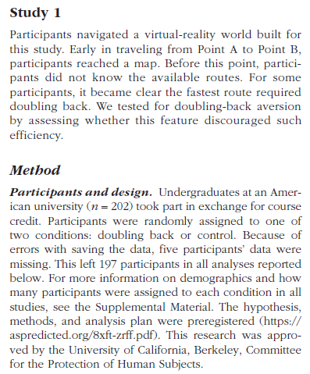
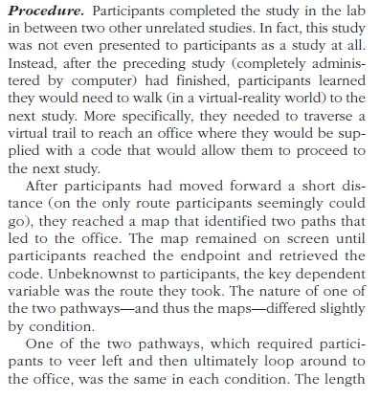
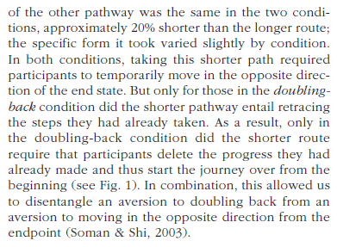

Slide 4
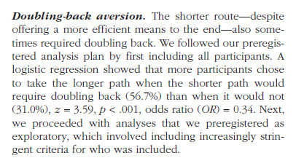
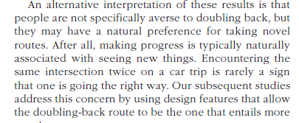

Slide 5
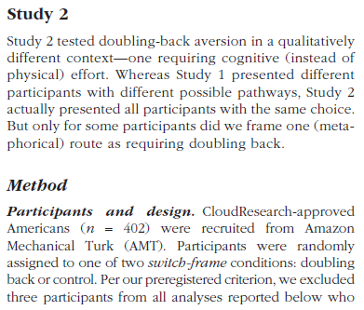
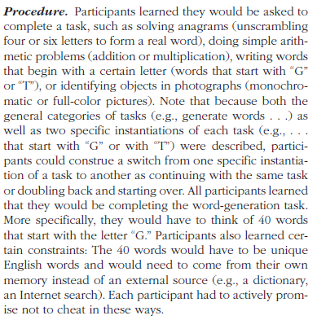
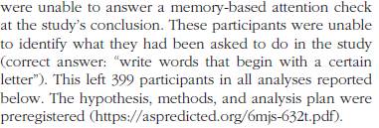

Slide 6
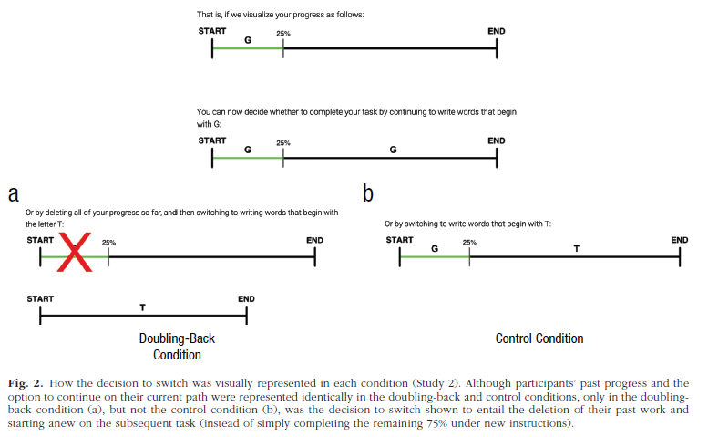

Slide 7

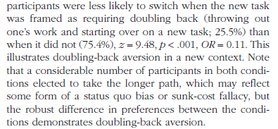

Slide 8
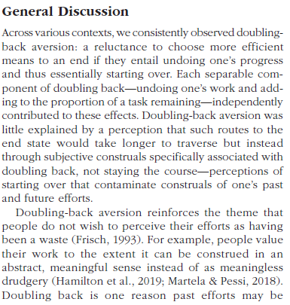
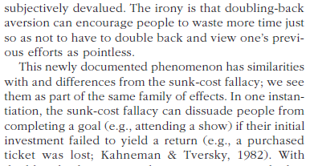

Slide 9
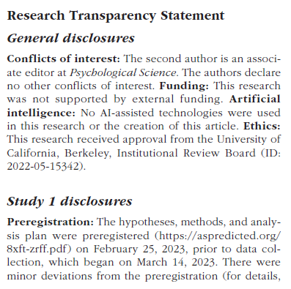
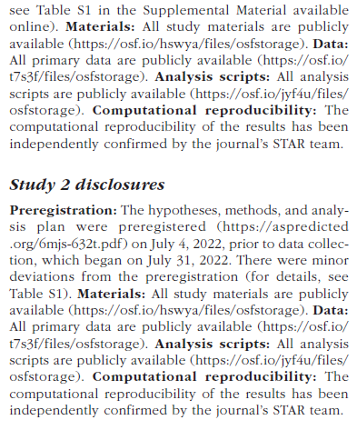
Rigor and reproducibility

Slide 10
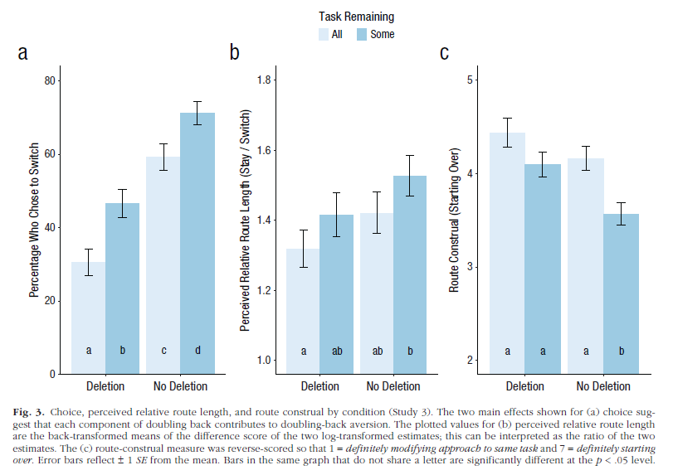
Example bar graph

Slide 11
APA Report Sections
Abstract
  Very concise summary, ~200 words
Introduction
  Construct, background, hypothesis
Methods
  Participants, materials, procedure
Results
  Figure
Discussion
  Conclusion, interpretation, limitations
References
See APA provided 7th edition sample “professional” paper for examples of manuscript format

Slide 12
APA Format: Methods
Which of the following is the main goal of the methods section of a research report?
  a. Meticulously articulate how you analyzed the data.
  b. Provide enough detail to allow an independent researcher to replicate your study.
  c. Outline the demographic information of your participants so that reviewers can access the generalizability of your research.
  d. Discuss the procedure you used so that readers can decide for themselves if your protocol is biased.

Slide 13
APA Format: Results
Which of the following is usually beyond the scope of the results section of a quantitative research report?
  a. Discussing what statistical techniques were used
  b. Presenting figures and/or tables to portray the data
  c. Providing detailed interpretation of the implications based on the data
  d. Presenting specific statistics that were generated from the data

Slide 14
APA Format: Discussion
If you state alternative explanations in your discussion, which of the following should you also consider doing?
  a. Tell readers why the alternative explanation falls short of the primary explanation
  b. Conduct statistics tests to test them specifically
  c. Include reviewer opinions of whether they think the alternative explanation is better or worse than the primary explanation
  d. Present a literature review that would allow readers to conduct a follow-up study based on the alternative explanation

Slide 15
APA Writing with Style
What is the role played by answering the question “who will you write for” in writing a research report? How should the answer influence the writing process?
Citing previous research
  Craik & Tulving (1972) proposed that better memory would research from more semantic engagement with the material being studied and termed this “deeper” processing.

Slide 16
Background literature
APA format for the References section
  Craik, F. I. M., & Lockhart, R. S. (1972). Levels of processing: A framework for memory research. Journal of verbal learning and verbal behavior, 11(6), 671-684. http://dx.doi.org/10.1016/S0022-5371(72)80001-X.
  Craik, F. I. M., & Tulving, E. (1975). Depth of processing and the retention of words in episodic memory. Journal of experimental Psychology: general, 104(3), 268. http://dx.doi.org/10.1037/0096-3445.104.3.268.
Notes:
Demonstrate use of google scholar

Slide 17
Theory: “Deep” Encoding
Hypothesis
  What is it?
  What isn’t it?
Mechanism
  Inferred
Specific Procedures
  Used in studies to test
  Combination of testing operational definitions and underlying theory
  What if our study hadn’t worked?

Slide 18
Research Context
Building on existing work
  Strengthens confidence in conclusions
  Very briefly review theory/mechanism
Adding something new
  What is new about our study?
  Motivate the current study to add to prior work

Slide 19
Experiment 1 Methods information
Participants
  28 students from two sections of a Research Methods classes
Materials
  A set of 60 words was used for the study and test stimuli. Words were selected to have a written frequency of 30-80 per million and to be 5-8 letters in length.
Procedure
  4s time per word to rate (automatic advance)
    “For each word, rate how much you like the word on a 1 to 5 scale. 5 means you like the word very much and 1 means you dislike the word very much. Indicate your rating with keyboard or mouse.”
    “For each word, count the number of vowels in each word. Enter the number with keyboard or mouse"
  3m delay period completing trivia questions
  60 item post-test, 30 old, 30 new

Slide 20
Results
Include all of:
  Descriptive statistics: mean, SD, SE
  Inferential statistics: t-test in APA format
  Figure & caption
As discussed in class, the text report will be very compact following the template we filled in during class Wednesday

Slide 21
First writeup
Include title page, abstract
Introduction: 1-2 paragraphs citing prior work, noting what is new about this study
Methods: full detail
Results: full detail including Figure and caption
Discussion: 1-2 paragraphs summarizing conclusion, note limitations
  Finish on strong positive statement!
References:

Slide 22
For Mon Oct 6
Chapter 8, Within-participants design
Bring any questions on the first writeup

